Slide 1


Global Energy
Christopher Swires
Jay Boon
Saloum Bouchaaya
Huseyin Teyfur
Christopher Alvizures

Slide 2

Build a better Tomorrow
Which energy source will have the biggest impact on our future: renewable or traditional nonrenewable resources?

Slide 3

Let’s think about:
Global energy consumption
Changes in trends
Sources consumed
Future energy consumption

Slide 4

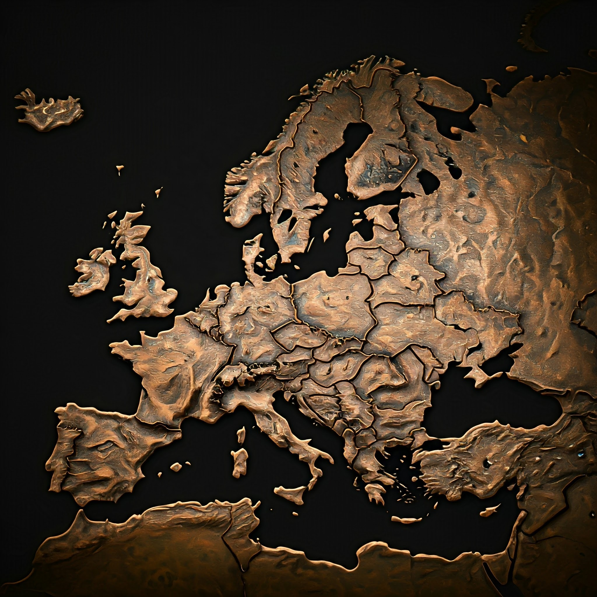


Dive into Data
219 Countries
6 Continents
8 Energy Resources
Consumption Per Capita
Consumption Per Energy Source
Total Energy Use

Slide 5

Energy Sources around the World
Biofuel
Coal
Gas
Hydro
Oil
Solar
Wind
Nuclear

Slide 6

Energy Source Classification
Oil – The dad
Coal – The grandfather
Gas – The oldest son
Hydro – The daughter
Solar/Wind – The youngest twin brothers
Nuclear - The mom
Biofuel – The dog

Slide 7
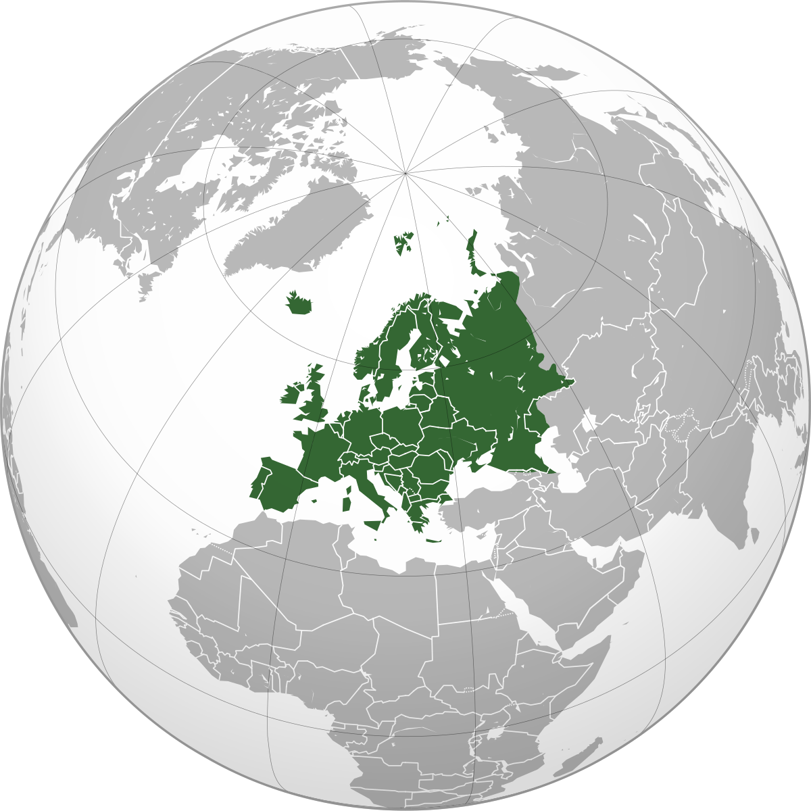
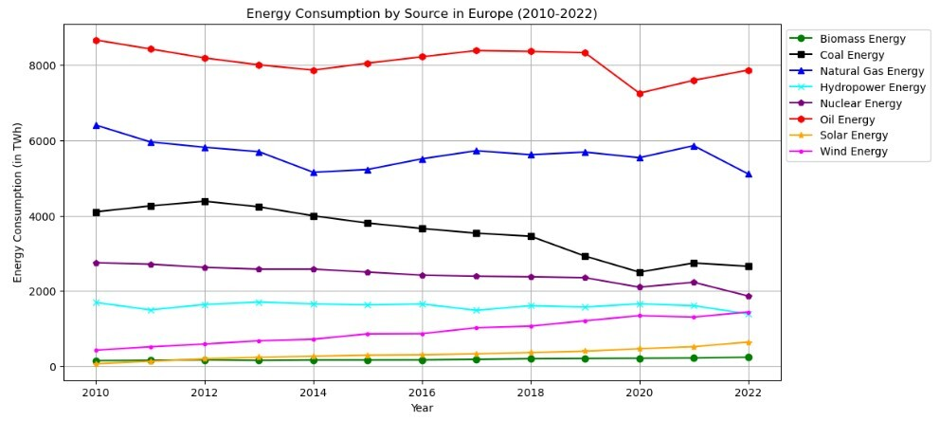
Energy Consumption: Europe (2010-2022)

Slide 8

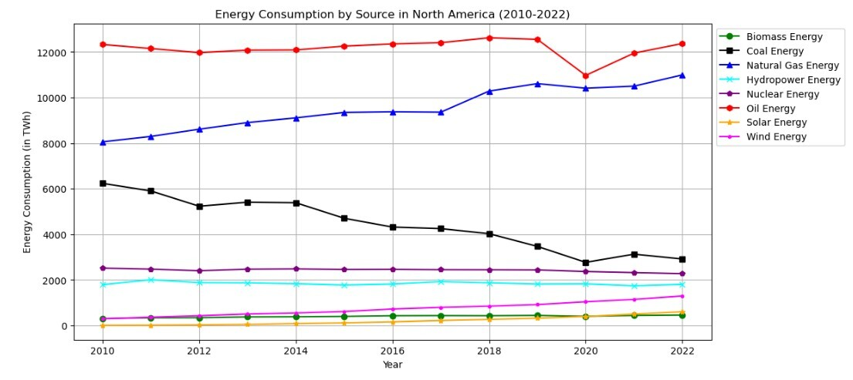
Energy Consumption: North America (2010-2022)

Slide 9

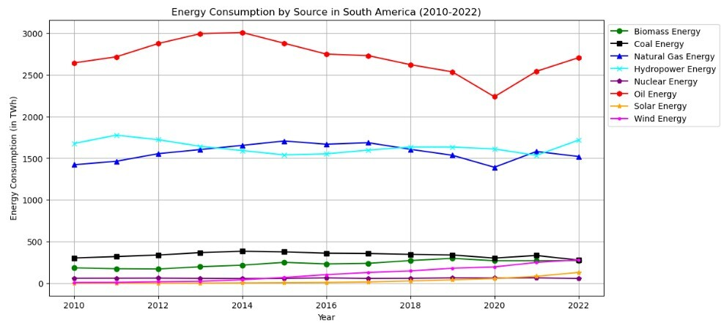
Energy Consumption: South America (2010-2022)

Slide 10

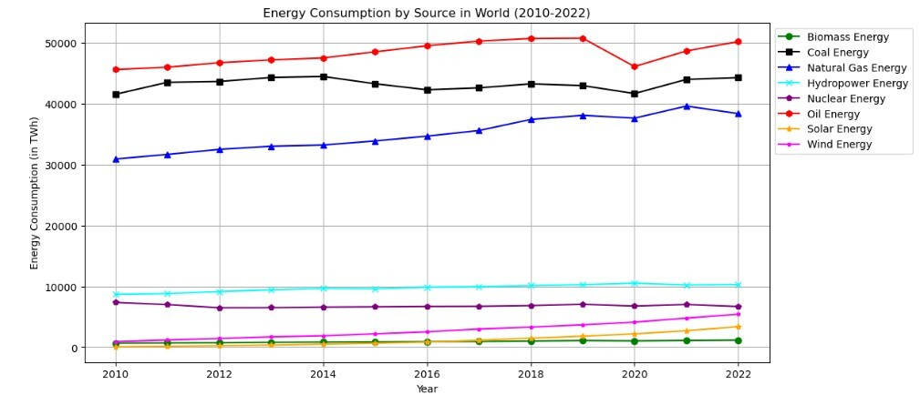
Energy Consumption: World (2010-2022)

Slide 11
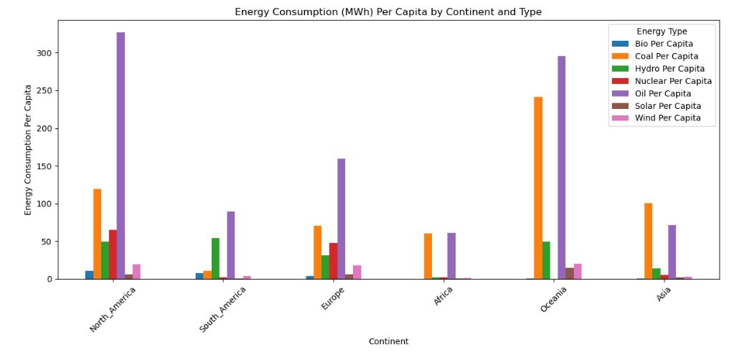
Energy Consumption: Source per Capita (2010-2022)

Slide 12
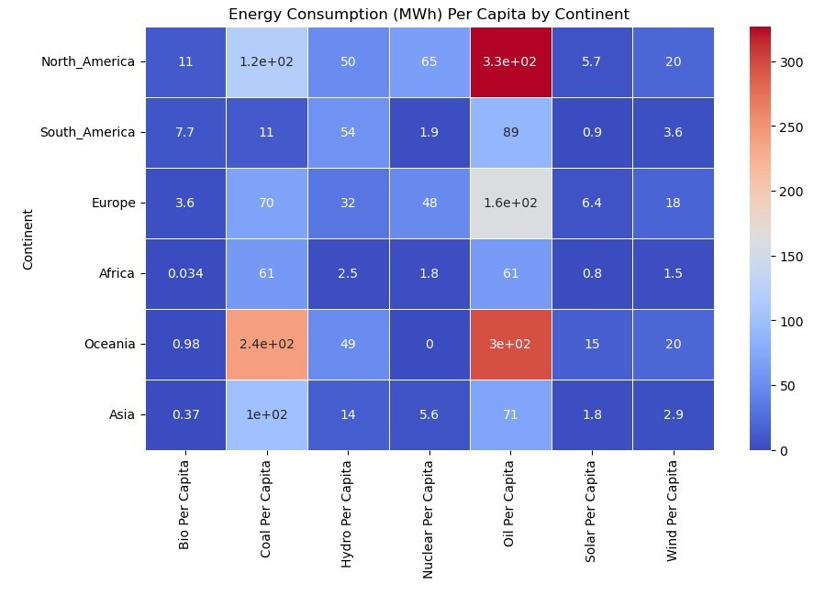
Energy Consumption: Source per Capita (2010-2022)

Slide 13
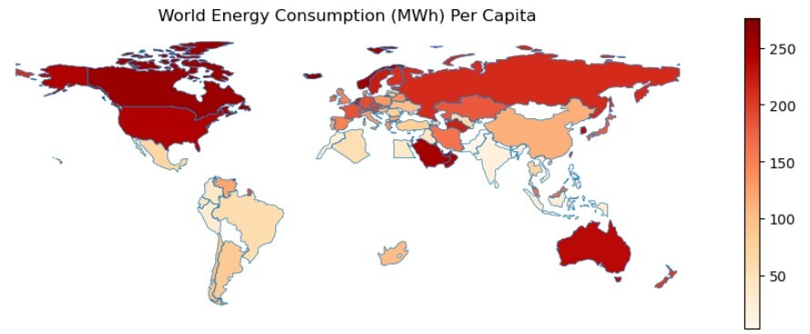
Energy Consumption: World Map (2010-2022)

Slide 14
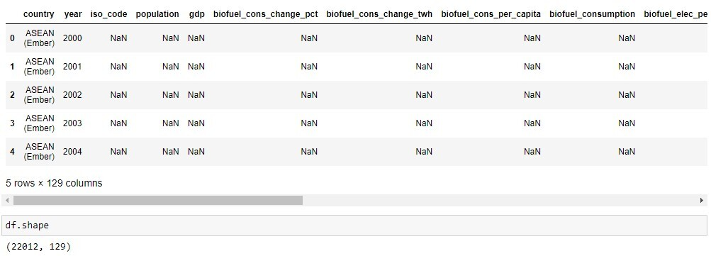
Break into Data

Slide 15
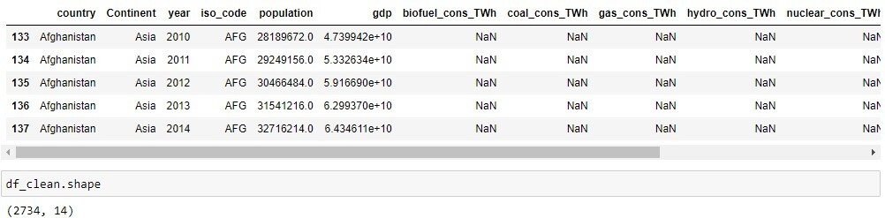
Break into Data

Slide 16
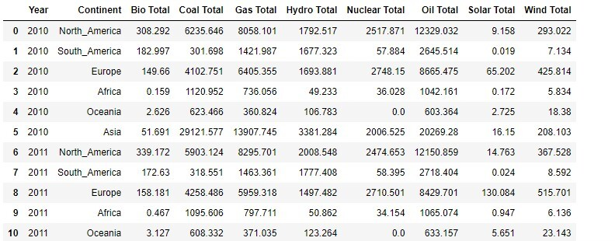
Break into Data

Slide 17
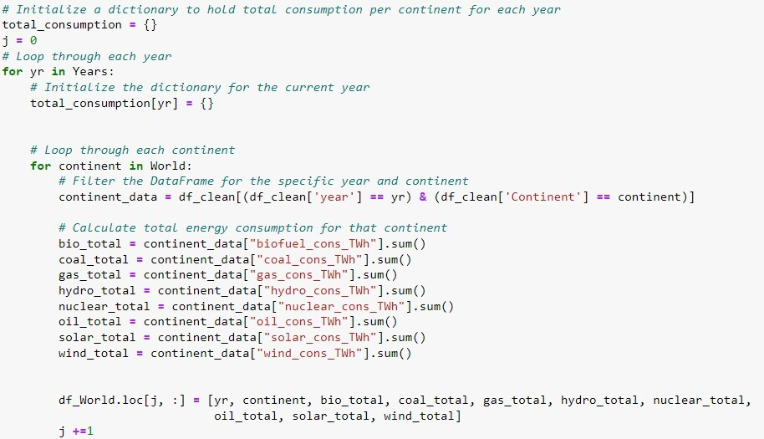
Break into Code

Slide 18
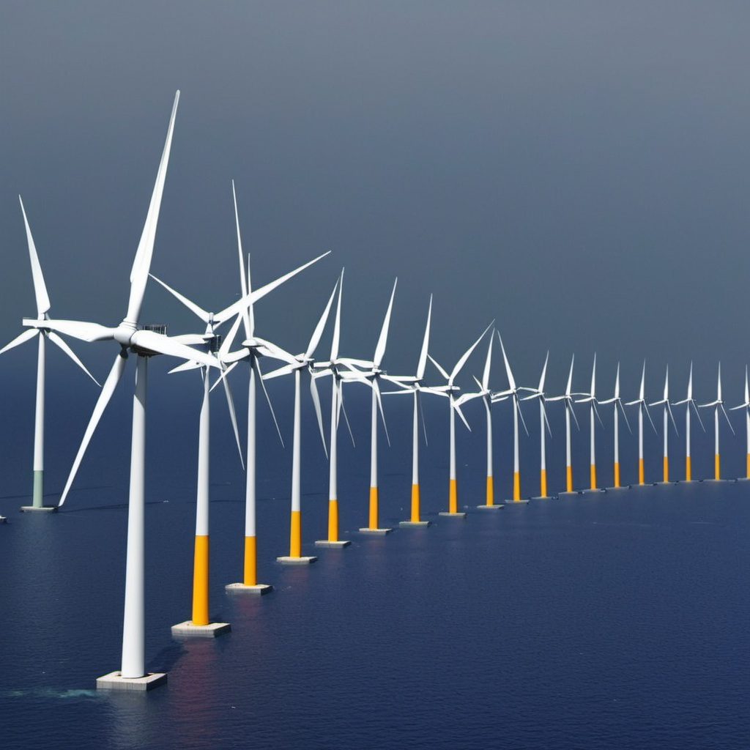
Key Take Aways
Oil was main energy source from 2010-2022
We saw dramatic change in energy use from 2019-2020
Coal was the second most used energy source
There has been a gradual decline in coal usage
Solar and wind energy usage have gradually increased

Slide 19

Looking Forward
Wind/Solar consumption is most likely to strengthen
Implement higher usage of solar panels and wind turbines
Oil consumption is most likely to stay consistent
Continue usage with most reliant consumers
Coal consumption is most likely to weaken
Decrease consumption in lieu of renewable resources

Slide 20
Credit
Data Sources:
https://www.kaggle.com/code/jackjaehwankim/which-countries-use-fossil-fuel-most
https://www.kaggle.com/datasets/pralabhpoudel/world-energy-consumption
Framed, Charted, & Presented by:
Christopher Swires
Jay Boon
Saloum Bouchaaya
Huseyin Teyfur
Christopher Alvizures

Slide 21

Questions?

